Slide 1
Actor Model
By Nchor Michael

Slide 2
Background
In the past programs only run sequentially. Concurrent Programming becoming more popular programs can now deal with multiple smaller tasks in overlapping periods of time. E.g. Today’s multicore system devices.
Actor Model solves the shortcomings with Concurrent Programming Invented by Carl Hewitt et al. in 1973.

Slide 3
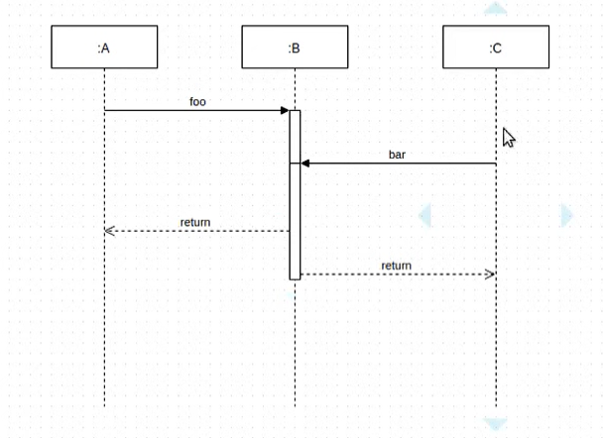
Shortcomings of Concurrent Programming
Object A sends message to B to access function foo. Object C also sends message to access function bar to B. If foo and bar both mutate data, we’ll have a Race Condition.

Slide 4
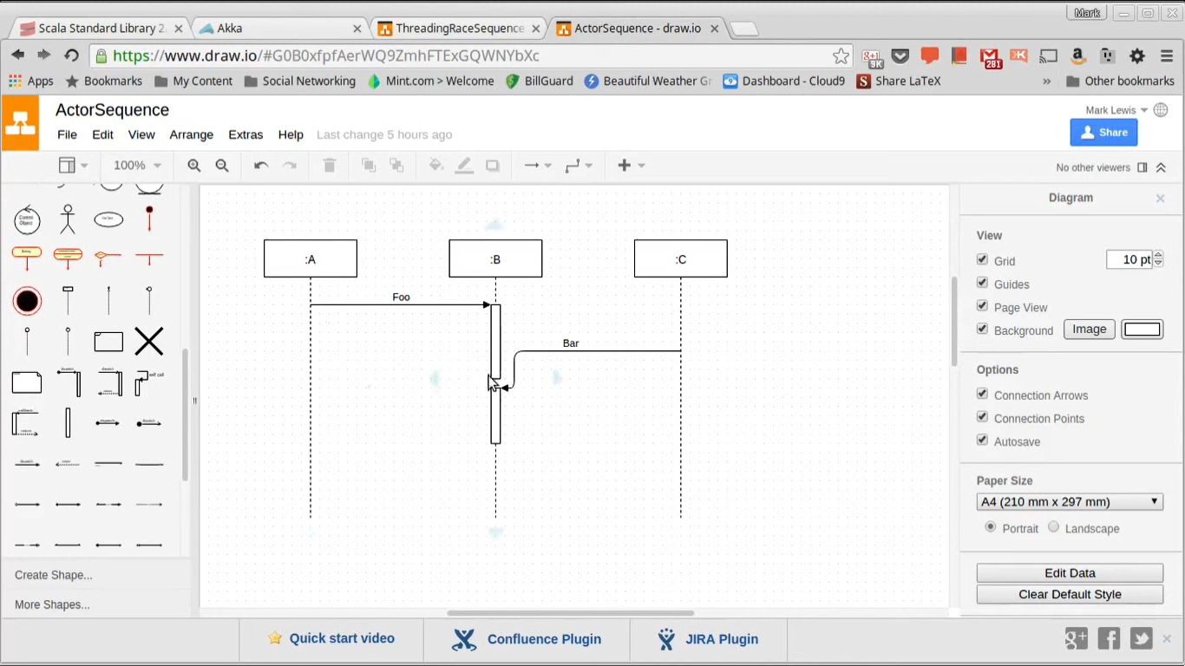
Solution: Actor Model
Object C now waits for Object B to complete Object A’s task and return the result to A before proceeding with Object C’s.

Slide 5
What is Actor Model
Programming Abstraction Model consisting
Asynchronous messaging
Mailbox Principle
Atomic Turns
Some implementations of Actor Model Include Akka.Net and Elixir.
Top companies like WhatsApp, CISCO, Walmart are reported to use Akka based frameworks to support high number of concurrent computations.

Slide 6
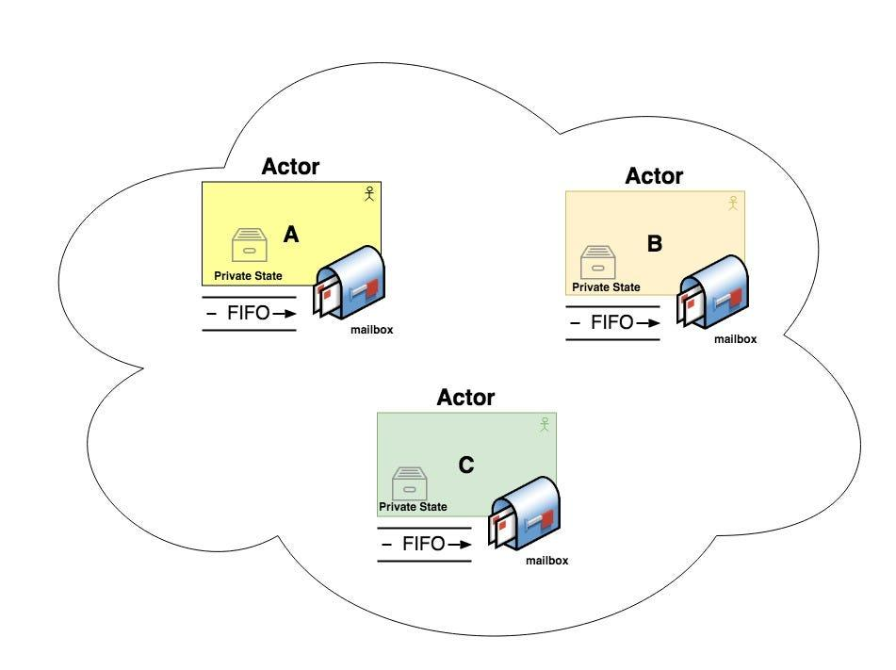
Illustration of Actor Model
Actors communicate with only actors whose address they know.

Slide 7
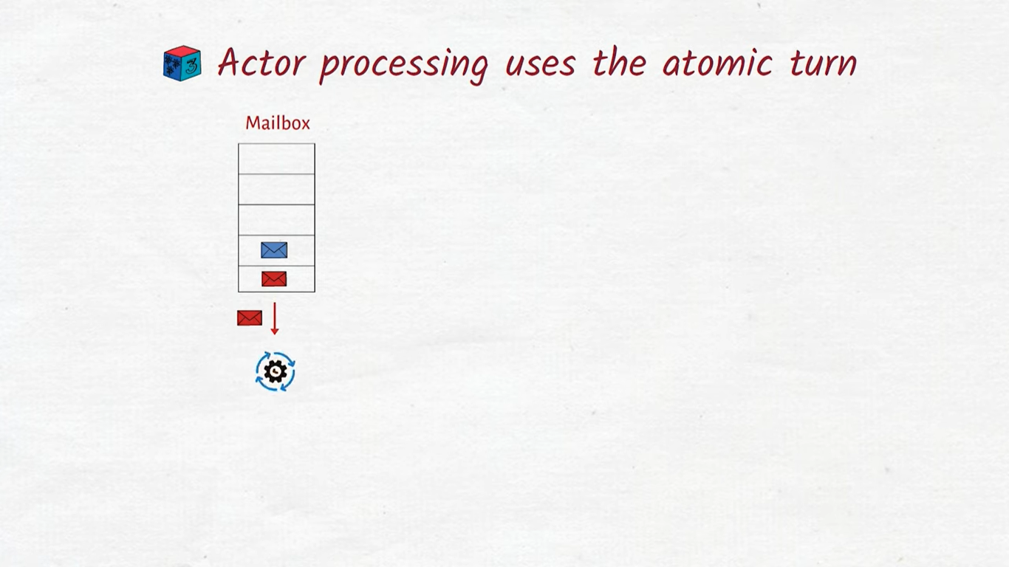
Mailbox Principle
Messages are received conceptually in a mailbox.
Messages are executed in turns in FIFO order.
Messages are executed in Atomic turns.

Slide 8
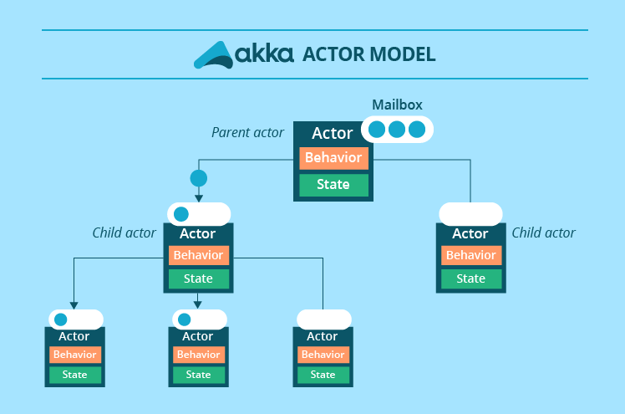
X’tics of Actors
Sends messages to other Actors (only if address is known)
Spawn other Actors
Change its code for next turn
Alter its local state
Actors spawn child actors
Can Supervise other Actors it creates.

Slide 9
Pros and Cons
Actors susceptible to deadlocks (Two or more processes are waiting for each other to release a resource).
Mailbox Overflow.
Easy to scale
Fault tolerance/Self Healing (Any exception is handled by parent Actor so doesn’t break anything)
Geographical Distribution
No Shared State

Slide 10
Applications of Actor Model
Electronic mail (email) can be modeled as an actor system. Accounts are modeled as actors and email addresses as actor addresses.
Web services can be modeled as actors with Simple Object Access Protocol (SOAP) endpoints modeled as actor addresses.

Slide 11
THANK YOU

